Slide 1
Welcome

Slide 2

A
Project Report On
Grocery Delivery Shop
By
Susmita Bajarang Sone
Batch: 2022 – 6522
Center:Thane

Slide 3
Under the Guidance of
Chittaranjan Ghosh
Technical Trainer
EduBridge
(School of coding)

Slide 4
Introduction:
Online Grocery Shop is a form of ecommerce that allows consumers to directly buy fresh food staffs or produce from a seller over the internet. An online grocery shop evokes the physical analogy of buying produce like it is done in a local market. The largest online retailing corporations are e-Bay and Amazon.com, both of which are based in the US. These giant online shops have with time been able to add to their sales the ability to sell fresh food and other home products through the internet.
Online markets have been a thing that has come to stay with the society of today since most financial transactions can be attained online. Internet access has vastly grown across the world today and has given rise to interconnectivity even to the remotest areas in the world. This generally means it is possible to be at any location and reach any other location in the world without stepping a foot out of your premises. This takes multi-tasking to another level since you can be in a meeting and visit a market located several kilometers away at the same time.

Slide 5
Objective:-
The aim of this project it to give information about the content of any shopping center to anyone who so wants to check current prices of available products, order products, spend less time in the market and shopping centers to reduce the stress and hustle of shopping and finding of customers.

Slide 6
The Objectives of using an online grocery market are to: -
Provide accessible information about products to customers who have are cut off by distance of other constrains but need to shop or window shop.
To minimize the difficulty of business owners from finding customers and reducing the cost of advertisement which are paid to most radio and television stations who genuinely allocate smallest of their broadcast time to such broadcast.
Eliminate the unwanted patrol of window shoppers who take up space in various shops and markets. This goes a long way to reduce human traffic in our markets.
Extremely minimize the losses due to shoplifting and cost associated with security

Slide 7
Modules:
Shopping Management
Customer Management
Manage Transactions
Transaction and Reports Management

Slide 8
Advantages of the proposed system
This grocery shop will be an online shop. This makes it possible for anyone to access it anywhere in the world. Below are some benefits of this;
Incredible
Price comparisons is made possible
It comes with the infinite choice for customers to see the best product available.
Customer reviews are made relevant and leave comments for other shoppers to read for better shopping experience.

Slide 9
Scope of the proposed system
The online grocery market will be made up various parts which include:
Product catalog- An organization of the products will be made for clear navigation of the site which will mean it will be browseable by all
Product attributes- Customers need to what product they need before logging on to make a purchase. Attributes are generally accepted as a must: product name, category, description, price, and photo / image of the product.
Check out- The eCommerce checkout needs to provide a way to take payment, append relevant taxes (if necessary), compute shipping and handling costs, provide a sub-total of the amount due, collect billing and shipping information from the customer.
Reporting & order tracking.-Some stores have a way to track the status of the order through the fulfillment and shipping stages.
Security is vital- The website will be encrypted with HTTPS, at a minimum to ensure losses are not made.

Slide 10
Software Requirements:
Front end: HTML , CSS , Javascript
Back end: Java, Spring Boot,MySQL
Operating System: Windows 10

Slide 11
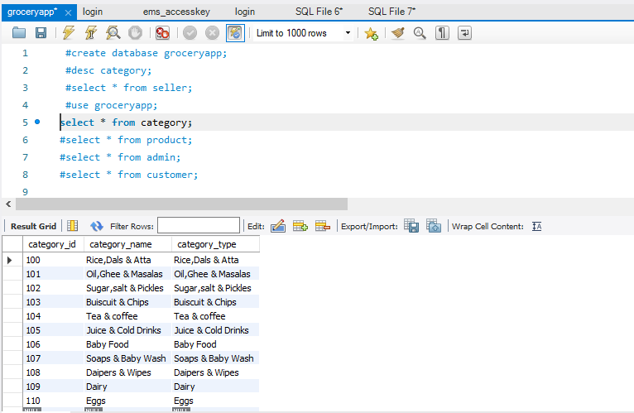
Database For Category

Slide 12
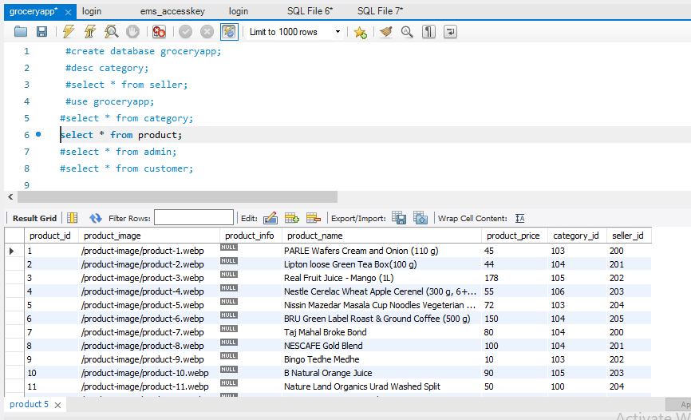
Database For Products

Slide 13
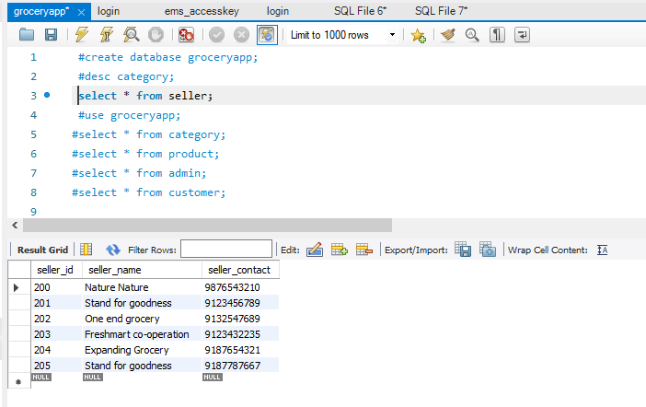
Database For Seller

Slide 14
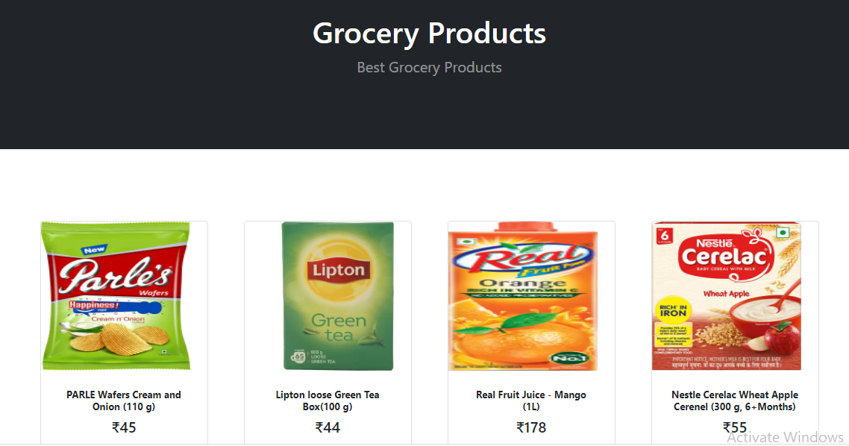
Output Section
Homepage

Slide 15
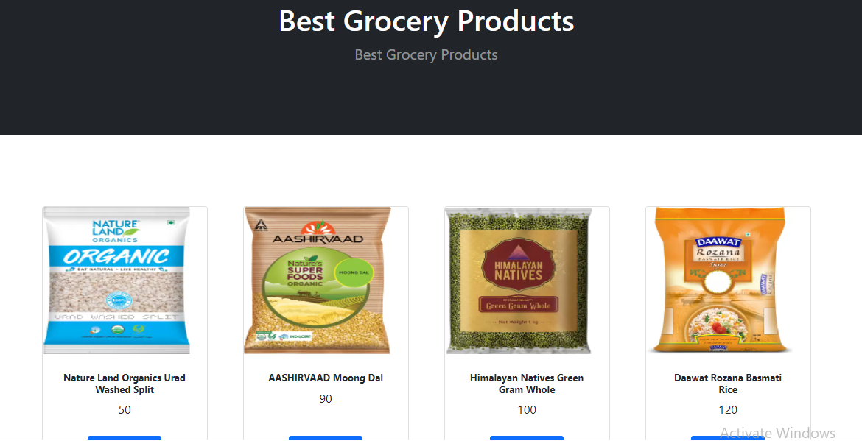

Slide 16
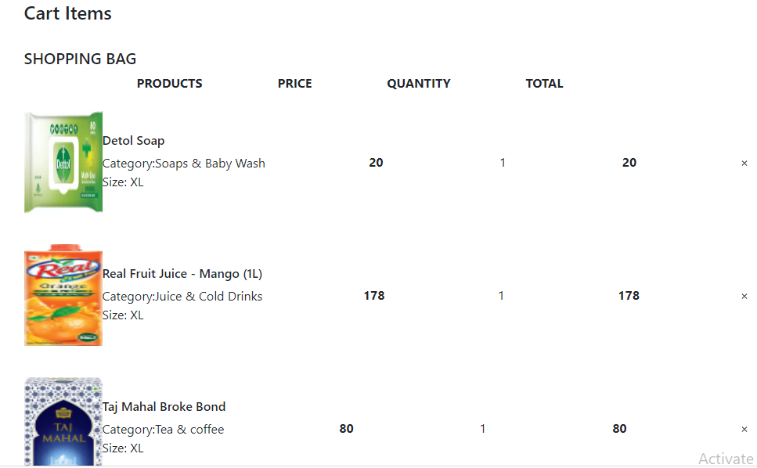

Slide 17
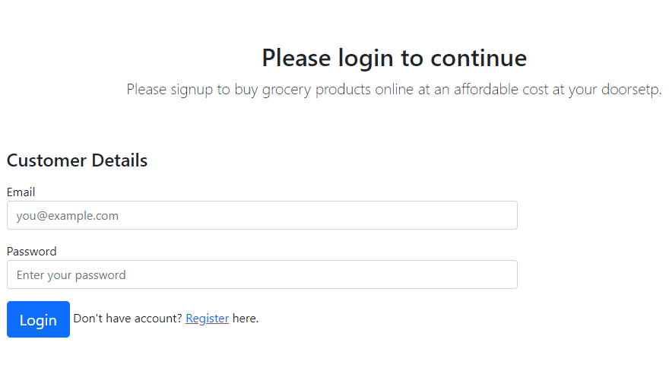
Customer Login

Slide 18
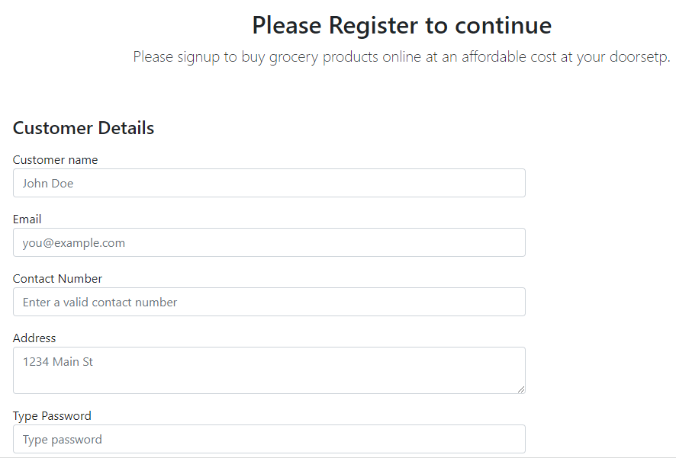
Customer Registration

Slide 19
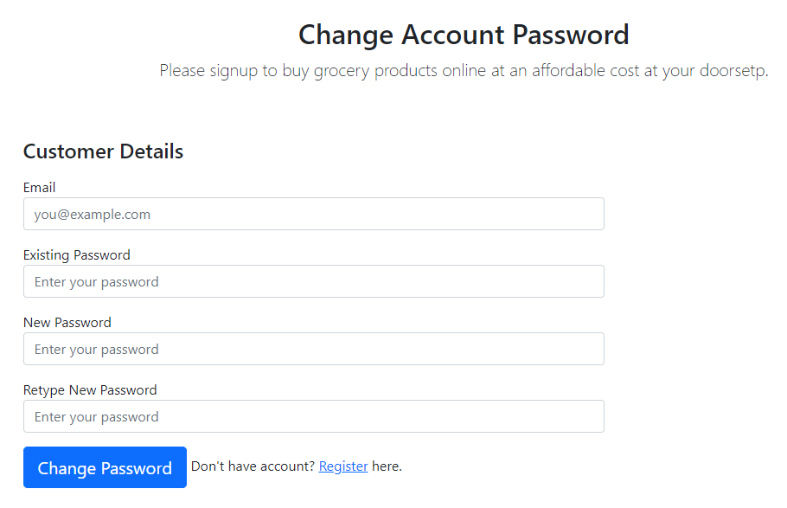

Slide 20
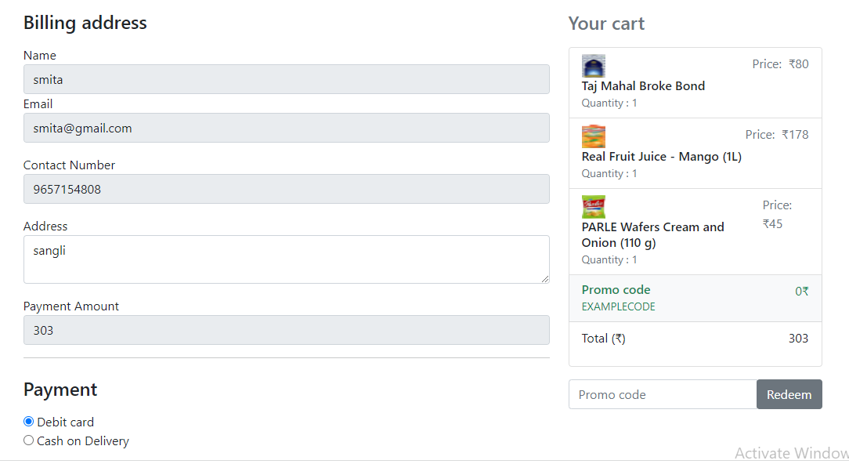

Slide 21
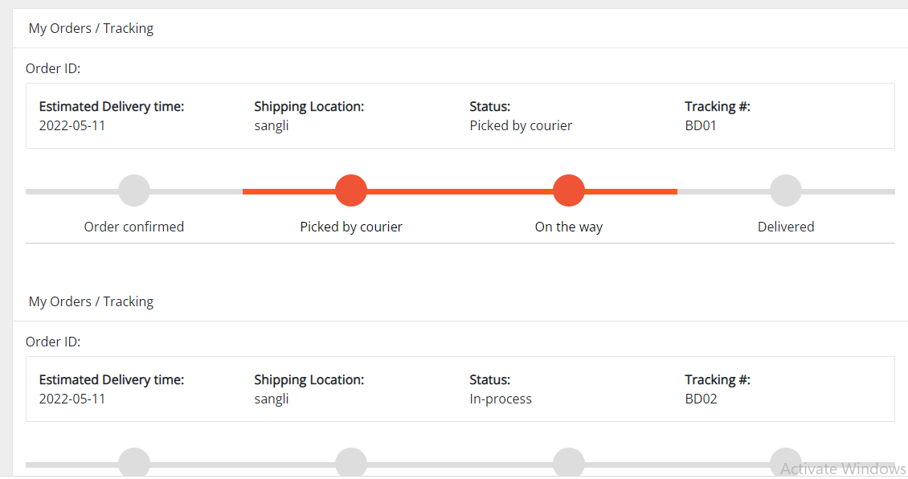
Order Status

Slide 22
Thank You

